Slide 1

The Shannon River Basin Challenge 2025
Jakub Piwosz

Slide 2
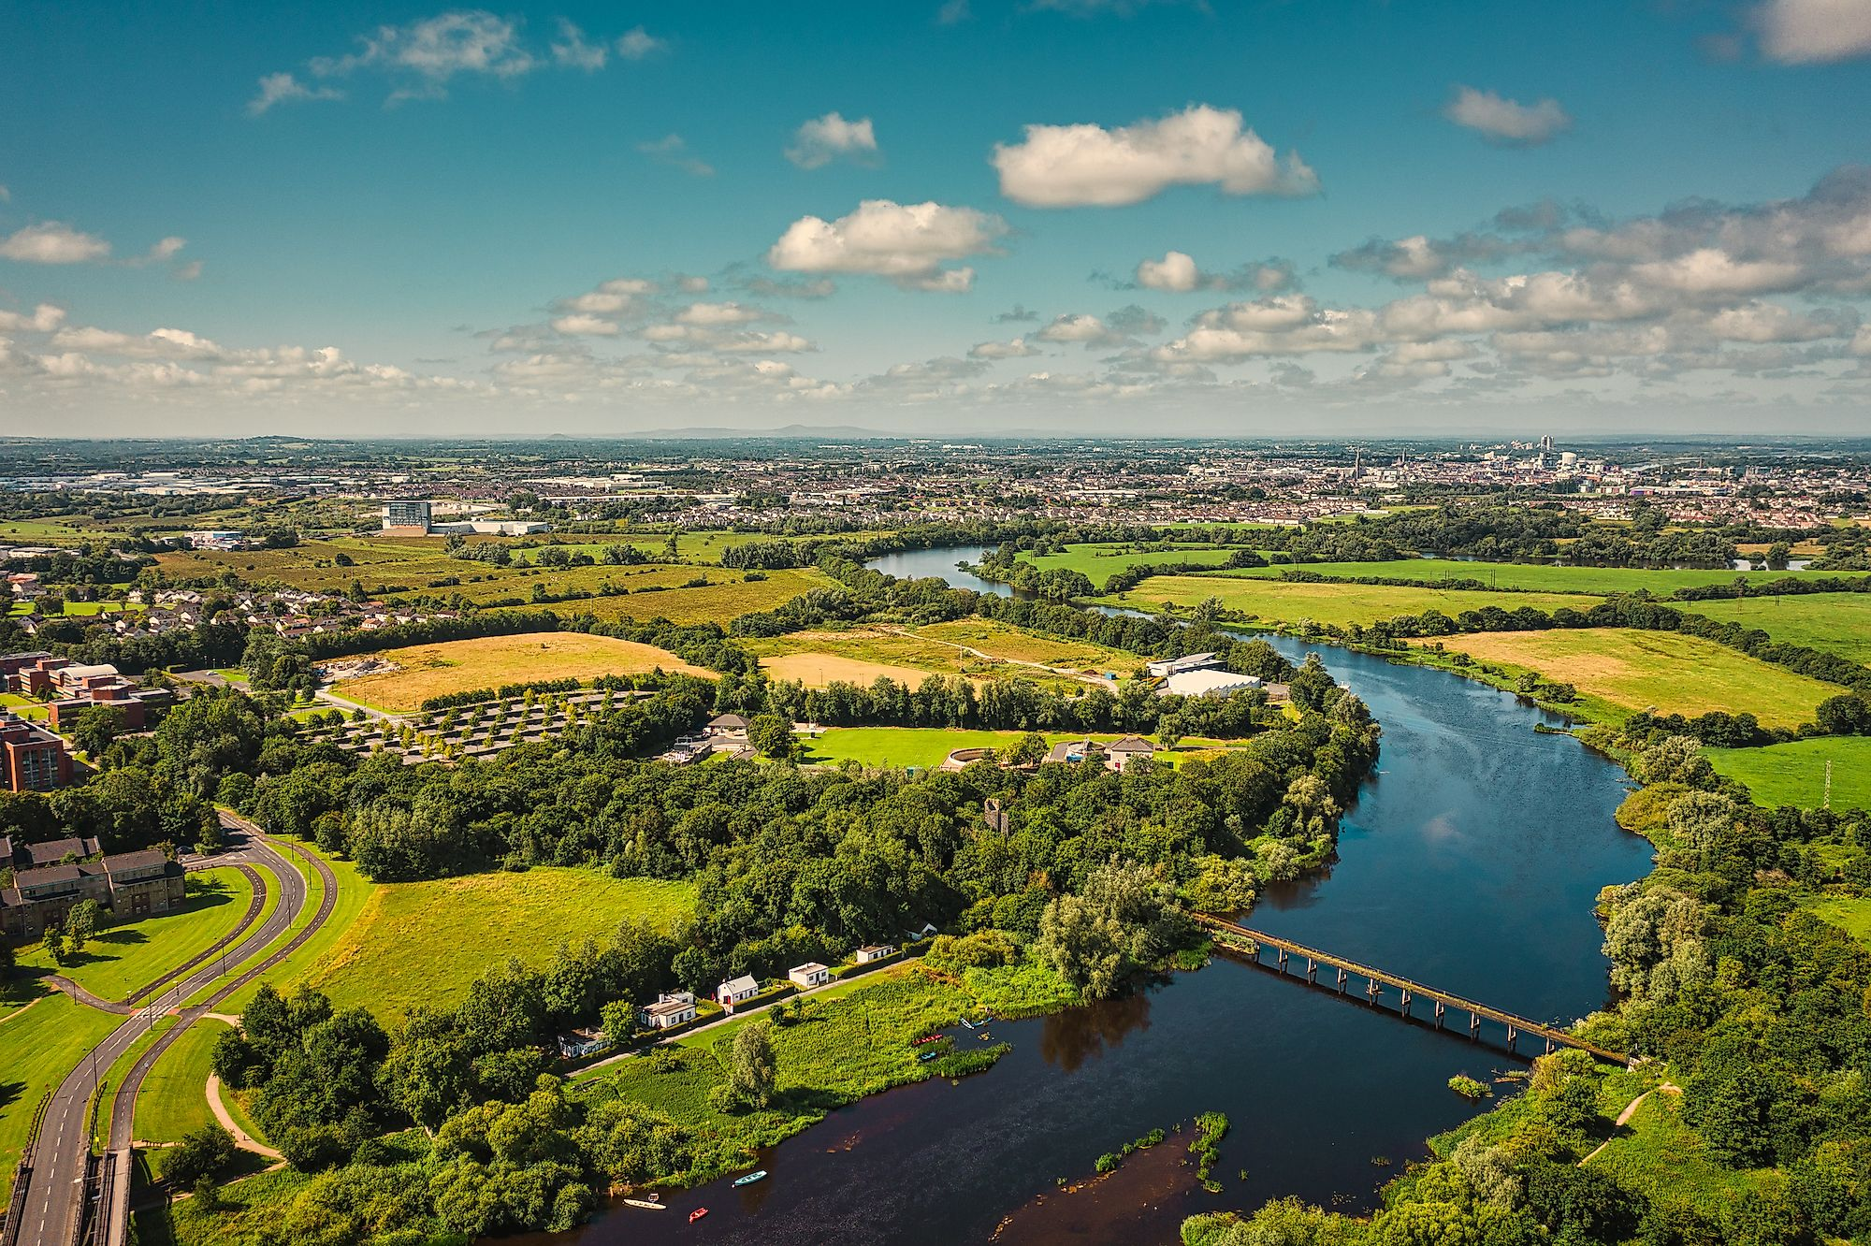
Title : Flood-Radar
Why Does It Matter ?
Throughout time flooding in the Shannon Area across the Shannon basin occurs frequently and is not just a seasonal inconvenience and it continues to be a growing threat to homes , agriculture , biodiversity and infrastructure. Traditional flood maps have always been simple , static and top – down view.
So what’s missing ?
Well the answer is that traditional food maps lack local-insight , real time adaptation and diagrams that include story telling which act as a measure of predicting the effects of the flood and what people can do in order to best prepare.

Slide 3

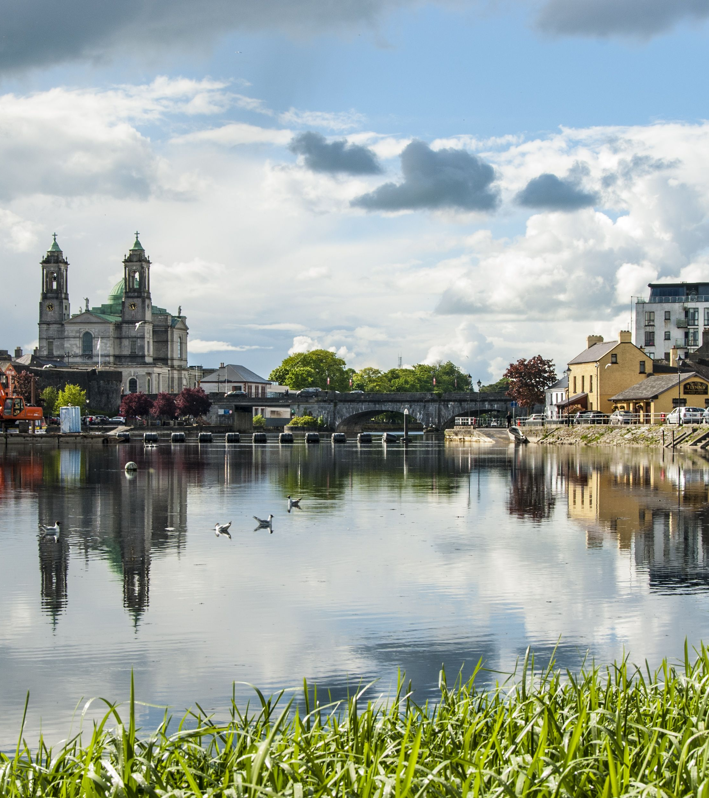
Why Are We The Right People For This Challenge ?
There are many reasons why we are the right people for this challenge , but in my opinion one of the main reasons why this challenge suits our team perfectly is because ¾ of us are from Athlone and have lived here for most of our lives and we have many family members located here too.
Due to Athlone's location being on the bank of the river Shannon this means that from a young age we have been exposed to the river and just how prone it is to flooding and the damage that it can cause to land and property due to the water damage and we have seen this with our own eyes and understand just how devastating it is.
We understand that precautions can be carried out in order to prevent / reduce the potential damage that can be caused from the flood via the use of for example, sandbag barriers to prevent water from passing through them.
Local Eyes Global Vision

Slide 4
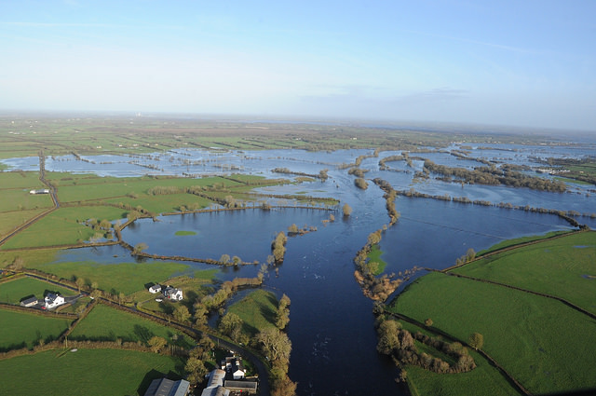
Problem Framing:
How can we create a collaborative yet interactive platform where residents and researchers can simulate possible flood scenarios which may potentially occur in the near future , while also doubling as an interactive platform for residents that allows them to discuss and ask questions to one another about possible future floods and what they should do in order to prepare accordingly depending on the severity of the flood.
“It isn’t just about predication but also about participation and planning.”
Expected Outcomes :
Difficulty : Advanced or Intermediate
Flood Radar will empower the 22,000 residents of Athlone to better protect them self’s from flooding.
A 3D flood simulation tool constructed using Three.JS as it a framework allowing you to utilise 3D models. This would be used to show water levels in specific areas while also clearly highlighting what areas are highly prone to flooding and specific infrastructure vulnerabilities.
A possible solution sandbox simulator where users can drag and drop interventions such as Sand Barriers , Wetlands , Levees and ext.
Flood Radar will complement existing flood maps by adding real-time community-driven simulation.
A community layer where users can interact with each other by discussing ideas to shape future planning against flood protection

Slide 5

What makes our solution and approach unique ?
It’s not just predictive , it’s interactive and co-designed by the users of the application themselves.
Invites and allows local knowledge to be considered in the planning process.
Transferable to other flood prone regions and can be re-used in other counties or even countries.
It is inspiring for school students , climate activists and councils.
Scope :
Includes -->
3D visualization, community / user input layer, simulation logic, real time environmental data and open source collaboration. Users can enter hypothetical future climate scenarios like 30% more rainfall in 2040 to explore long-term resilience
Does not Include -->
Physical infrastructure construction or government policy enforcement and high-fidelity engineering simulations.
Resources :
Met Éireann rainfall data
CFRAM flood risk maps
EPA Geoportal
EPA hydro net datasets
Three.js and open source simulation libraries
Local council archives
Map Genie by Tailte Éireann
GeoHive
Waterlevel.ie
FloodInfo.ie
Lets build a flood free future together !

Slide 6
Inspiration And References :
🌊 Flood risk and hydrology:
Managing Flood Risk on the Shannon Managing Flood Risk on the Shannon | River Shannon Group
Flood Mapping and Data Resources
Shannon Town Flood Relief Scheme
Shannon Town and Environs FRS – Home
🗺️ Mapping & Visualization Tool
EPA Maps Viewer --> EPA Maps
Environmental Sensitivity Mapping
Environmental Sensitivity Mapping (ESM) | Maynooth University
🌐 Three.js & Interactive Visualization Inspiration
Environment map — Three.js Journey
110 three.js Examples | FreeFrontend
🧪 Water Quality & Catchment Report
Upper Shannon Catchment Report (2024)
26G Upper Shannon Catchment Summary WFD Cycle 3.pdf
EPA Water Quality Dashboards
Data - Catchments.ie - Catchments.ie

Slide 7
All Sources
Open Spatial Data Portal
Hydrometric and Hydrological Data
Shannon Town and Environs FRS – Home
Managing Flood Risk on the Shannon | River Shannon Group
OPW Hydrology Reference Network - Dataset - data.gov.ie
Data - Catchments.ie - Catchments.ie
26G Upper Shannon Catchment Summary WFD Cycle 3.pdf
Clean water projects | Environmental Protection Agency
The Role of Volunteers and Citizen Scientists in Addressing Declining Water Quality in Irish River Catchments | Citizen Science: Theory and Practice
GeoHive Hub
MapGenie Mapping Services | Tailte Éireann
Environmental Sensitivity Mapping (ESM) | Maynooth University
Environment map — Three.js Journey
110 three.js Examples | FreeFrontend

